Slide 1


Radiation Therapy Therac-25
Nurullah MERTEL
18290219

Slide 2
Contents
Background
System Engineering Applications
Successful and Failed Processes
Improvements to the Life Cycle Stage
Conclusion
References

Slide 3
Background
The Therac-25 was a state-of-the-art medical linear accelerator in the early 1980s, but it was plagued by software problems that led to several fatal accidents.

Slide 4
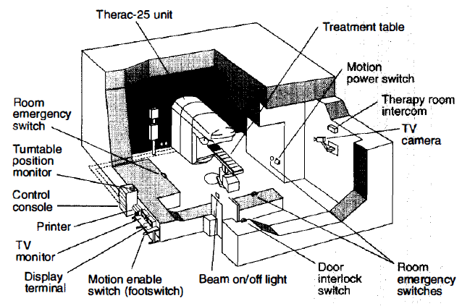
Background
Figure 1. Typical Therac-25 facility.

Slide 5
System Engineering Approachs
The Therac-25 failure was a classic example of a system engineering failure. System engineering is a discipline that applies engineering principles to the design and development of complex systems. The goal of system engineering is to ensure that all of the components of a system work together seamlessly to achieve the desired outcome.

Slide 6
System Engineering Approachs
There are a number of system engineering approaches that could have been used to prevent the Therac-25 failure. This process should have included the following steps:
Define the system: The system engineers should have started by clearly defining the scope and objectives of the Therac-25 project. This includes defining the system's requirements, constraints, and assumptions.
Design the system: Once the system requirements were defined, the system engineers should have designed the overall architecture of the Therac-25. This includes designing the hardware, software, and safety features of the machine.

Slide 7
System Engineering Approachs
Implement the system: The system engineers should have overseen the implementation of the Therac-25 design. This includes developing the software, building the hardware, and integrating the different components of the system.
Verify and validate the system: The system engineers should have verified and validated the Therac-25 to ensure that it met its requirements and was safe to use. This includes conducting testing and inspections of the system.
Deploy and support the system: Once the Therac-25 was verified and validated, the system engineers should have overseen its deployment and support. This includes providing training to users and providing maintenance and support for the system.

Slide 8
Successful Processes
The Therac-25 was one of the most advanced medical linear accelerators of its time, and its hardware was generally reliable. It controlled every aspect of the machine, including radiation delivery.

Slide 9
Failed Processes
The software contained several bugs that could cause the machine to deliver massive overdoses of radiation.
Therac-25's safety features were inadequate. While the machine had some safety interlocks, operators could easily bypass them.
The machine had no way to detect or prevent overdoses.

Slide 10
Improvements to the Life Cycle Stage
The Therac-25 case teaches us that software design and testing are essential for system engineering projects. The Therac-25 software should have been thoroughly tested before it was used in hospitals. Additionally, the machine should have had more safety features to prevent radiation overdoses.

Slide 11
Conclusion
The Therac-25 case is a stark reminder that system engineering is essential. System engineers must thoughtfully consider all aspects of a system, including software and safety, to ensure its safety and reliability.

Slide 12
References
incose.org/publications/products/se-handbook-v4
therac.pdf (mit.edu)
An investigation of the Therac-25 accidents | IEEE Journals & Magazine | IEEE Xplore
Medical Device Recalls: Examination of Selected Cases (dtic.mil)

